Slide 1

IPB University PowerPoint Guidelines
Study Program
Statistics and Data Science
Department of Statistics
…………………………………………
Name
Title
Location of talk,
Date of Talk

Slide 2

Konten
Layout
Preface Slide (Branding IPB University)
Title slide
Slide layout
End Slide
Elemen Desain
Font
Slide Transitions
Color Palettes
Graph, Chart & Organigram Examples

Slide 3

Preface Slide

Slide 4
IPB University PowerPoint Guidelines
Alternatif 1
Study Program
Statistics and Data Science
Department of Statistics
….Event…
Name
Title
Location of talk,
Date of Talk

Slide 5
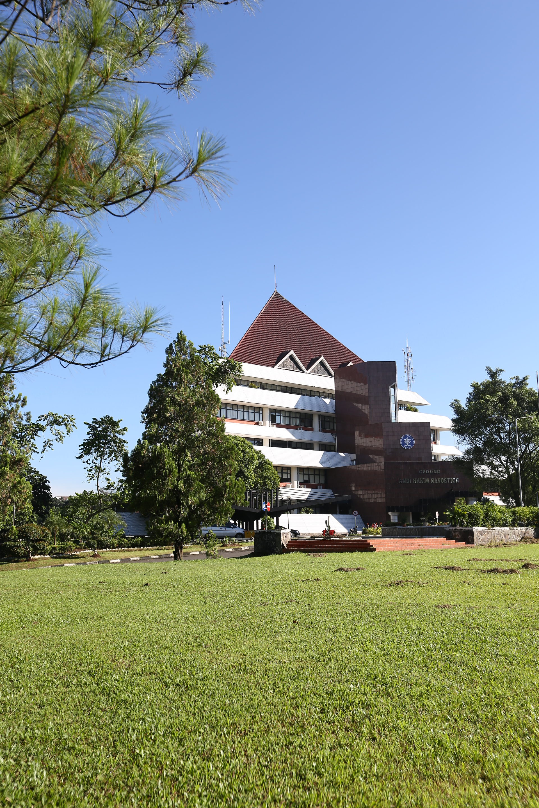
IPB University PowerPoint Guidelines
Alternatif 2
Study Program
Statistics and Data Science
Department of Statistics
….Event…
Name
Title
Location of talk,
Date of Talk

Slide 6
IPB University PowerPoint Guidelines
Alternatif 3
Study Program
Statistics and Data Science
Department of Statistics
….Event…
Name
Title
Location of talk,
Date of Talk

Slide 7
IPB University PowerPoint Guidelines
Alternatif 4
Study Program
Statistics and Data Science
Department of Statistics
….Event…
Name
Title
Location of talk,
Date of Talk

Slide 8
Slide Layout 1

Slide 9
Slide Layout 2

Slide 10

…..Kata/kalimat penutup…. (Terimakasih, quotes, pantun, dll.)
Alternatif 1
Department of Statistics
Jl. Meranti W22 L4
Kampus IPB Dramaga Bogor 16680
Telp.: 0251-8624535
E-mail: statistika@apps.ipb.ac.id

Slide 11
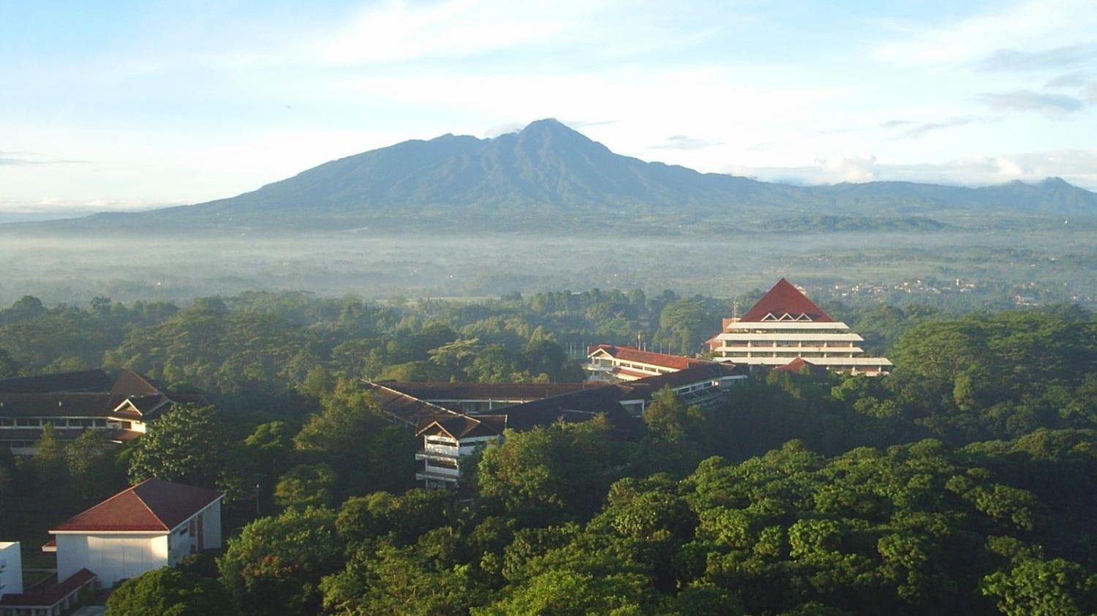
…..Kata/kalimat penutup…. (Terimakasih, quotes, pantun, dll.)
Alternatif 2
Department of Statistics
Jl. Meranti W22 L4
Kampus IPB Dramaga Bogor 16680
Telp.: 0251-8624535
E-mail: statistika@apps.ipb.ac.id

Slide 12
Background 1
Department of Statistics
Study Program Statistics and Data Science
IPB University

Slide 13

Background 2
Department of Statistics
Study Program Statistics and Data Science
IPB University

Slide 14
Ukuran Slide
Ukuran
Widescreen (16:9)
Standard (4:3)
Publish di web ipb.ac.id. Akses download hanya melalui akun apps.ipb.ac.id (bisa juga media branding yang lain)

Slide 15
Font & Transisi Slide
Font
Ukuran Font
Judul: 32
Sub Judul 1: 28
Sub Judul 2: 24
Sub Judul 3: 20
Jenis Font: Arial
Hindari garis bawah pada font
Transisi
Untuk konsistensi, transisi slide menggunakan fade style

Slide 16
IPB University Color Palette
Background 1:
Text 1:
Background 2:
Text 2:

Slide 17
Situs Download Gambar dan Icon (free)
Gambar:
pexels.com
pixabay.com
unsplash.com
Icon:
flaticon.com
iconfinder.com
icon8.com
freepik.com

Slide 18
Contoh Grafik

Slide 19
Contoh Pie Chart

Slide 20
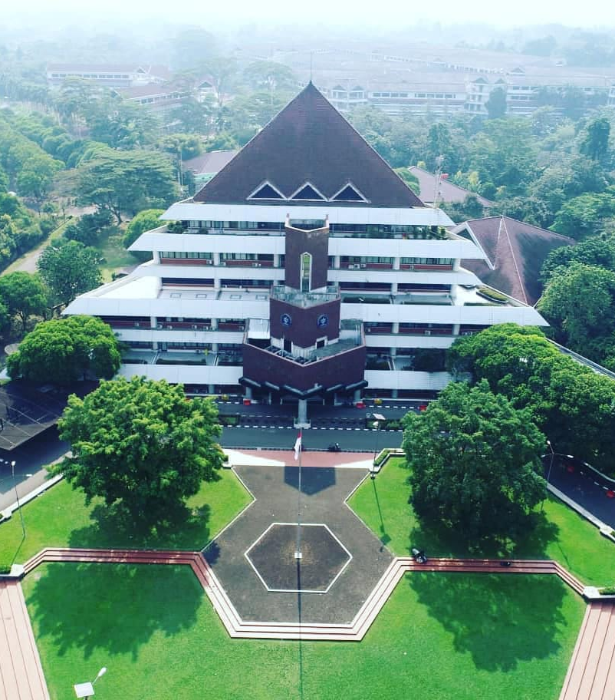
Contoh Peletakan Gambar (1)
IPB University

Slide 21
Contoh Peletakan Gambar (2)
IPB University

